Slide 1
Git & Github Workshop

Slide 2
Flow of the workshop
Periodically after few subtopics, there will hands on and then doubts clearing
During hands on, you are requested to follow along on your system
During presentation, if you face any doubts put them in the meeting chat, those shall cleared during the doubts session
We will try our best to clear all your doubts, but if some doubts that do not require publicly explaination, will be resolved through personal chat
We are happy to clear your queries, even after the workshop ends 😀

Slide 3
Learning Outcomes
Familiar with Basic Linux commands
Realize the importance of Version Control System
Be able to use Git to track your code
Be able to push and pull code from Github
Be able to send a PR properly to an existing Github Repository

Slide 4
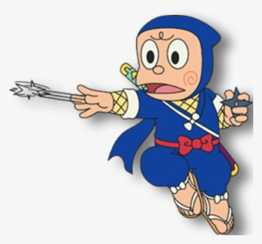
Become a Terminal Ninja
Its called Folder Directory
To know your current directory, just Print Working Directory using `pwd`
List the contents of the Current Directory - `ls`
You can Change Directory using `cd directory_name`
Come back a diretory using `cd ..`
You can make a new directory using `mkdir directory_name`
To read the content of files, just cat
Create files using “touch”
Add contents using “echo >”
Use cat to read the contents
Append contents using “echo >>”
Delete files using “rm”
Notes:
Include Demo
Explain that folders are called directories
Show ls command
Tell them to move to a directory using `cd`
Prove that directory has been changed using pwd
Come back using cd ..
Make ur own diretory - using mkdir

Slide 5
What is Git Anyway?
A software used to track your projects.Tracking means
Helps you have a backup
Maintain a history of changes,helps you compare different versions
Experiment without worries!
Colloborate effectively
Class of softwares which provide above features are called Version Control System.And Git is the most popular one
Notes:
Version Control system is a fancy name for software that stores also ur previous versions of ur code
When u normally write to a file, only the recent most version is saved. It is not possible to go back to the version of the file few days or months back, or may be hours back. We use VCS to track software!
// KIND OF ONE LINER FOR EACH
1 - Suppose you or someone accidentally deleted the Files, how do u get them back, bcoz git tracks it u can get back those deleted files
2 - Git tracks u at what stage of the project what changes were made. For example, u can think of building a code base equialent to writting a book. Suppose you have tracked your book using git. You can precisely track which chapter was written at what time. And what changes were made in the chapter
3. Suppose you made few changes to ur code base - by making changes in multiple files.and it is not working now and you want a demo immediately. What can u do? Undo those changes. But there are several files and in each file u made several changes. And you are amnesic! How do u undo? Git to the rescue!
4. How much work done by whom, and when/Multiple people working on project, you can track who made what changes. You can easily find the imposter who sabotaged the codebase!

Slide 6
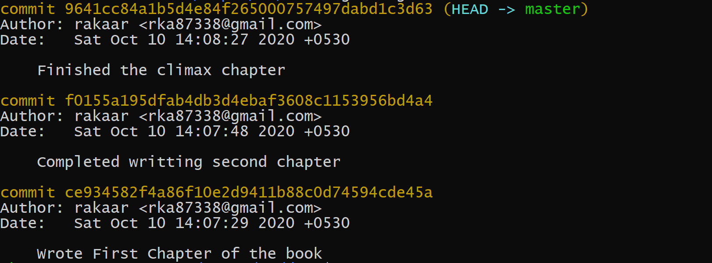
In what way does Git track?
So Git Tracks by taking snapshot of your project at different stages.
The Snapshot is taken when you save the state of your project by Commiting
Notes:
https://stackoverflow.com/questions/8198105/how-does-git-store-files#:~:text=Git%20doesn%27t%20think%20of,a%20reference%20to%20that%20snapshot.
Explaination of Book Commit history
As seen in the history, the author has saved the snapshots of his Book at each chapter
By doing so, he can
Know when he wrote a chapter
He can go back to a stage if doesn’t like.Suppose, if author didn’t like the climax, he can go back to the stage of the book, where only 2 chapters were there, And write a new Climax.
PIC OF THE STACKOVERFLOW

Slide 7
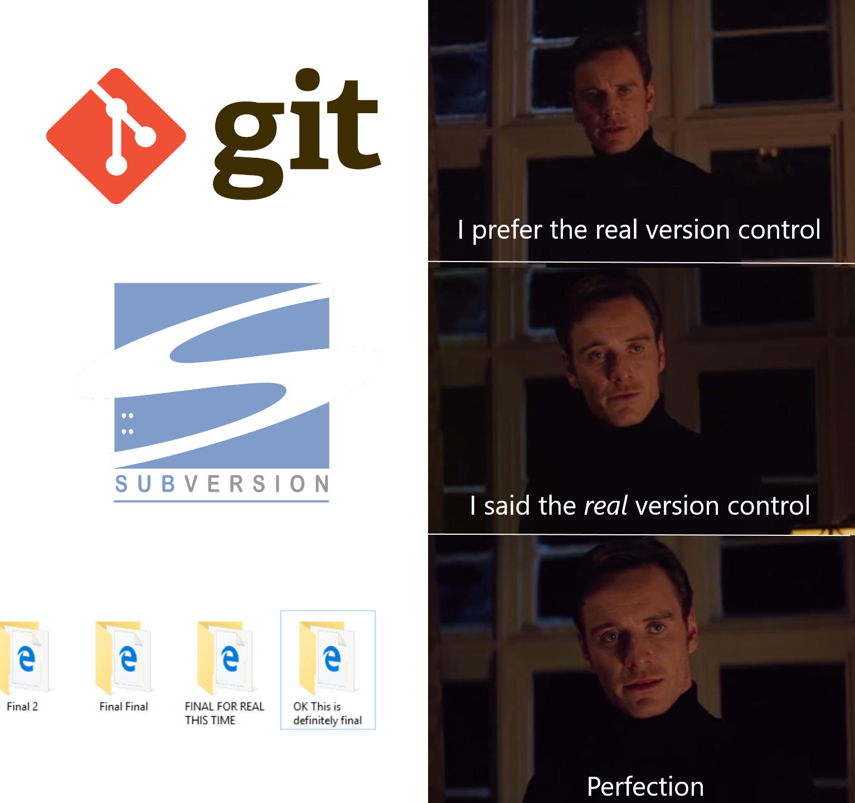

Slide 8
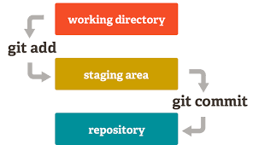
Mental Model of Git Workflow
Notes:
(THIS IS A USEFUL MENTAL MODEL TO SIMPLIFY THE UNDERSTANDING OF HOW GIT WORKS!)
Working directory is the directory which is being tracked by git, basically where u write ur code
When u create new files and start writing code in them and want to save a snapshot of the code
But before saving the snapshot
U have to ADD the files to the staging area.
By adding files to the staging area u mark that these are the changes in them, which u want to have the snapshot of!
And finally to save the snapshot, you commit!

Slide 9
DEMO
git init
git add FileName
git commit -m “A nice commit message”
Notes:
In demo
Make a new directory - “demo”
Move to the directory
Do git init
Do ls -la and show that git is tracking
Add a new file “chap1.txt”
Add some content in the file
“Now you want to save snapshot of the project at this stage”
After writing code and before saving the snapshot(commiting) you need to add them to the staging area
Git add filename
Git commit -m “Added new.txt file”
How do i check that it has been saved
Do “git log”

Slide 10



This Staging Area is Confusing!
WORKING DIRECTORY
STAGING AREA
COMMIT !
Notes:
You go to a Shopping Mall
You buy some items
Before taking to counter!
You put them in your Shopping Cart.
You can think this Shopping cart as ur staging area!
And the billing as comitting!
https://softwareengineering.stackexchange.com/questions/119782/what-does-stage-mean-in-git

Slide 11
Hands On by Building a “facebook Clone”
Notes:
Make a new directory facebook clone
Create new files - login.txt and homepage.txt and logout.txt
Tell them to use git add -A instead of writing all the three filenames
And tell them to write proper commit!
Now Make settings page and groups page
But add only settings page, because groups page is incomplete
Git status
Git add Settings.txt
Git status
Git commit -m “Added settings”
Git log
Git status
Change the messaging file also
Git add -A
Git commit -m “Added m” // every commit is accompanied with a msg
Git status - working tree clean

Slide 12
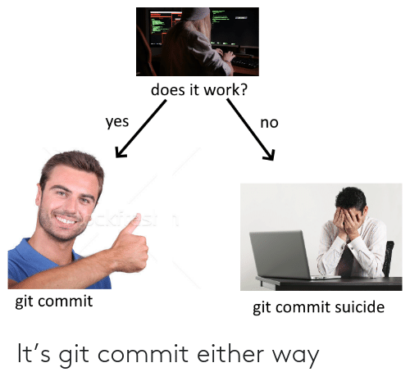

Slide 13
DOUBTS

Slide 14

JUMPING BETWEEN STAGES - EVIL CAT TRILOGY

Slide 15
Undo the changes after a Commit
Part 1
Working tree clean
Cat comes up and adds rubbish files and and garbage content
You come back and check git status. It’s too chaotic
You want to undo !
Just do git checkout .
And you have recovered your codebase

Slide 16
Restoring code after files are in Staging Area
Part 2
This time it plans to commit
It adds rubbish files and rubbish content
It does git add .
And luckily u come in time and it runs away
How do u unstage?
Git reset --hard HEAD
Notes:
TO BE CLARIFIED
HOW TO UNSTAGE
HEAD EXPLAIN

Slide 17
Going back to a Previous Commit
Part 3
This time the cat makes NOT 1 but 2 Rubbish commits 😦
Git reset --hard COMMIT_HASH_YOU_WANT_TO_GO_BACK

Slide 18
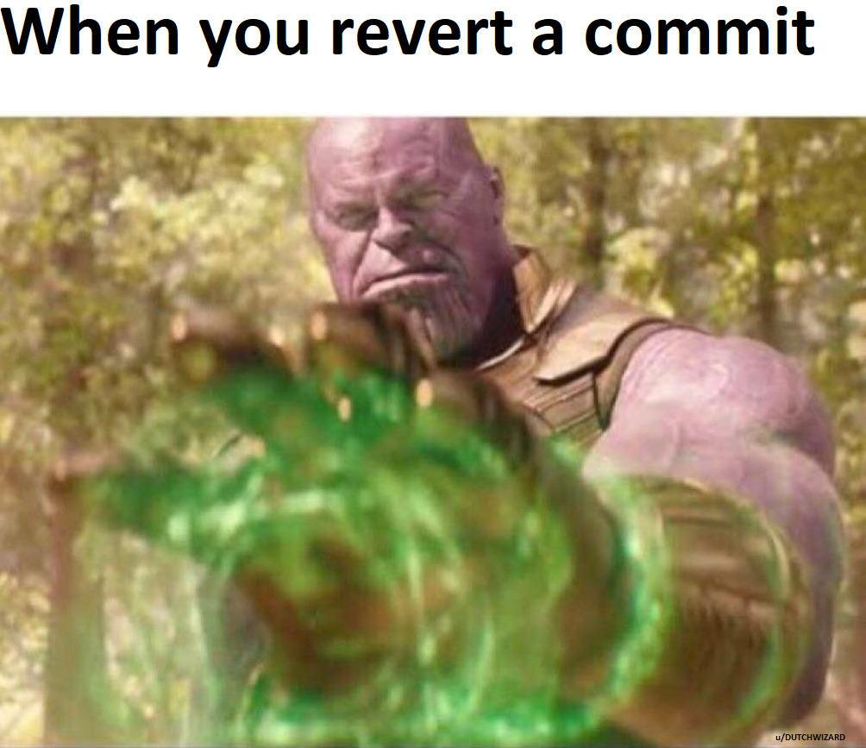

Slide 19

Intro to Branching
Notes:
Imagine 2 ppl working on a codebase, both want to work parallely and independely to speedup

Slide 20
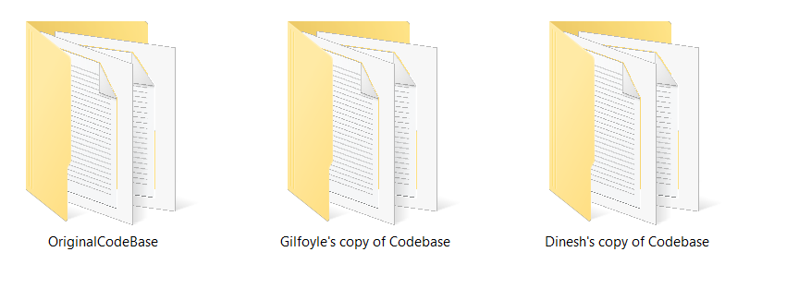
Notes:
Both work on different features, both make changes in a lot of existing files and create ton of new files
Imagine the effort that would requiring in brining all those changes into one codebase, you would have to compare the files individually line by line and then see what to add what to subtract
With large codebases this is virtually impossible task to keep manual track of wat u changed

Slide 21

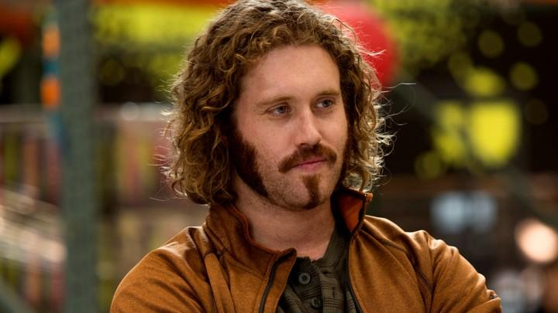
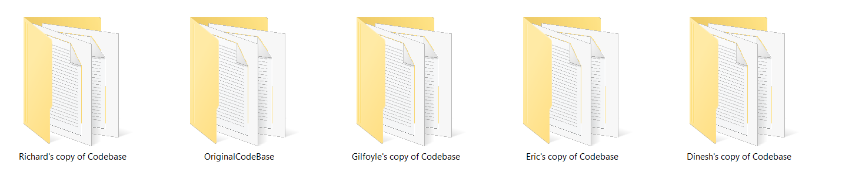
Notes:
What if there are more ppl, the number folders would group,
And it becomes a pain because each work at their own pace hence the slower guys need to update their code more frequently
So git has a wonderful feature called branching

Slide 22
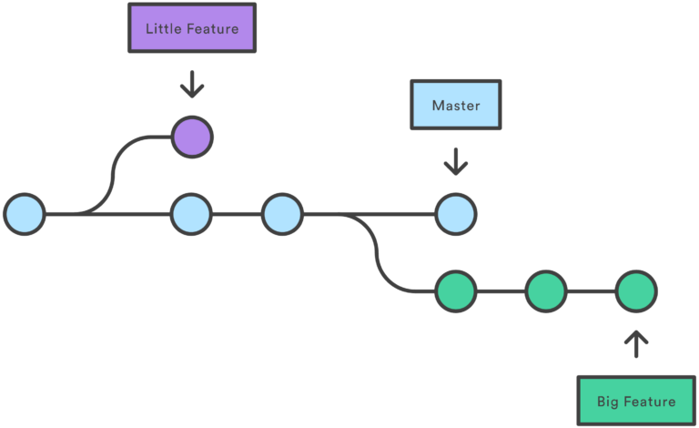
Branching
Notes:
Those cirlces u are seeing are nothing but commits
Git provides this feature called branching where you can literally jump to a virtual copy of codebase temporarily work on it, make commits and merge those changes into the main codebase with just a single command

Slide 23
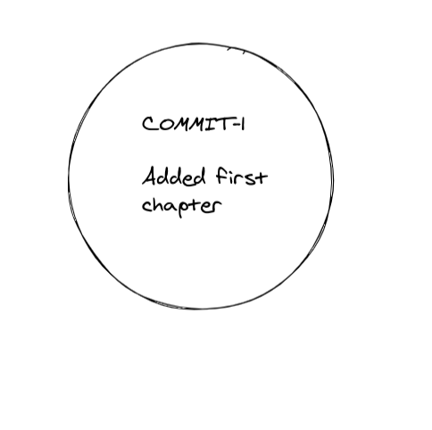
Branching
master
branch
Notes:
COME BACK TO THINGS LIKE AUTHOR 1st, 2d 3rd chapter
Then another branch ch4, ch5, then merge in the final draft
// Branching is like Save as - https://betterexplained.com/articles/aha-moments-when-learning-git/
Now I want to think you repository as a series of commits. C1 -> C2 -> C3 (IMAGE OF C1 -> C2 -> C3)
What if u want to try out a new experiment, but u are not sure whether to include it in the final draft or not?
And u don’t want to mess with the main repository
What would you do?
Create a copy of the repository, give a different name to it!
Now what if u want to perform multiple experiments(more than 1)?
Multiple folders?
Lets assume u have 3 such folders, the main and other 2 experimental.
Luckily both ur experiments went good! And u want to have both of them in ur final draft
What do u do, open 2 repos at once, compare file by file the difference and ultimately include the changes in one repository
This is such a pain
Git provides a feature called `branches` which help u achive the same with very little effort
After C3 u want to experiment, so u hop on to a new “branch” which we call “experiment” (IMAGE OF NEW BRANCH C1 -> C2 -> C3). Its called a branch because it is kind of diverging from the tree
And u make 2 new commits say E1 and E2 (IMAGE OF E1 and E2)
And u are happy with the code, so ultimately u would like those changes in the master branch! (IMAGE OF C1->C2->C3->E1->E2 and below branch)
U can simply merge them in master and Delete off the experimental Branch(ONLY master image)
Now with hands can get a better understanding
Git branch -Now by defautl u are on a branch called master
So u want to experiment a new feature in FB-clone called “poke”
So u create a branch called “poke” by git branch poke
Do git branch again and show that there are 2 branches
But u are still on master
To shift to the poke branch, do git checkout poke
Do git log and see
Now u see that u have the same history of commits
and lets add poke feature - git add ., git comit -m “added poke”
And git log, u have poke feature on ur poke branch
And it seems good and u want include this on master
go to master and do git log
U see the “poke “ commit is not there because it was on a different branch -”poke”
So what u want to do is literally merge those changes in master branch,
So that comand is git merge the branch name
Git log , show them that poke commit is there
And show the file
Tell them u can delete the branch by git branch -D poke

Slide 24
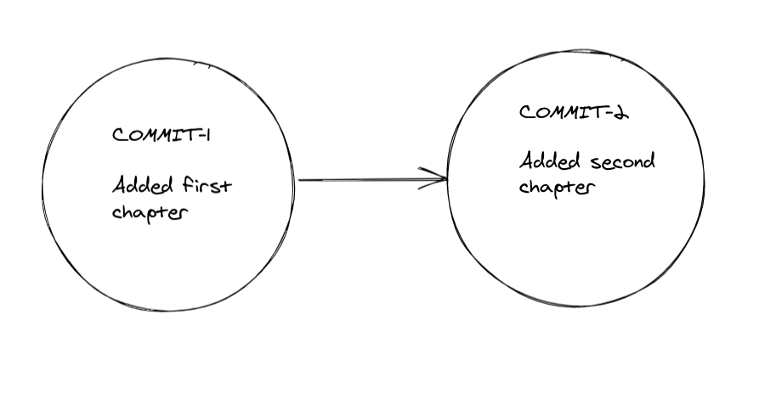
master
branch

Slide 25
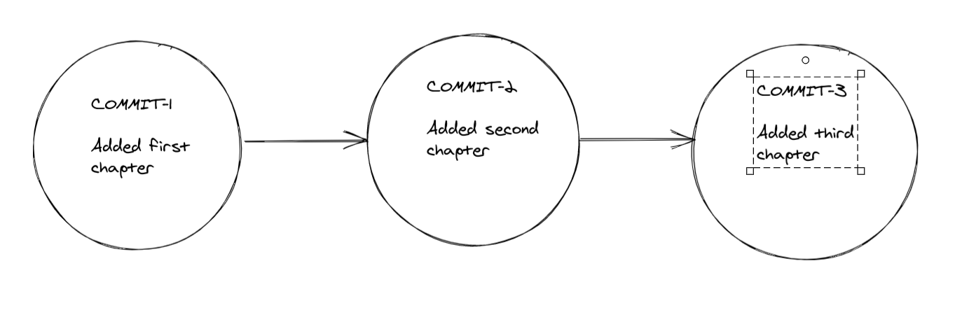
master
branch

Slide 26
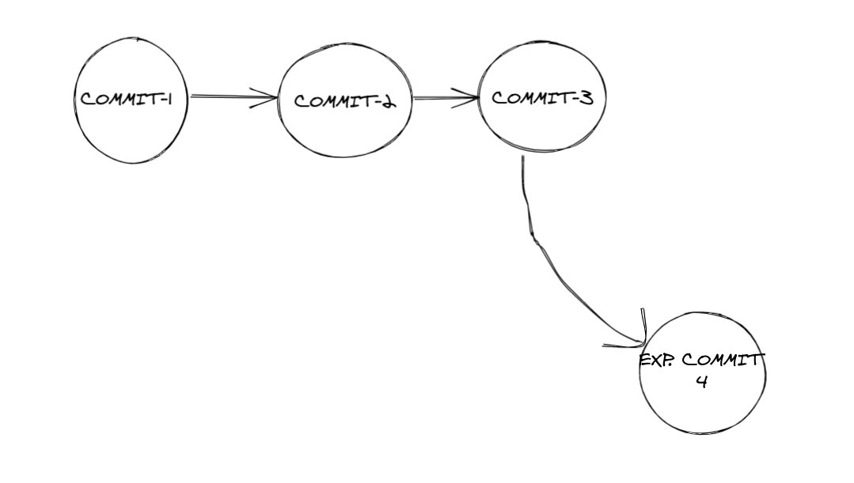
master
branch
exp
branch

Slide 27
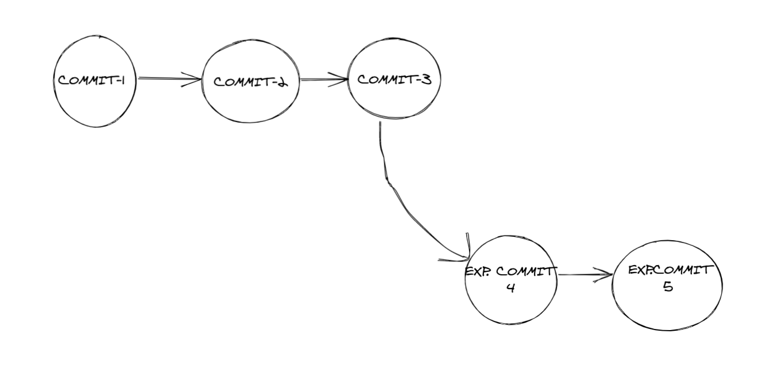
master
branch
exp
branch

Slide 28
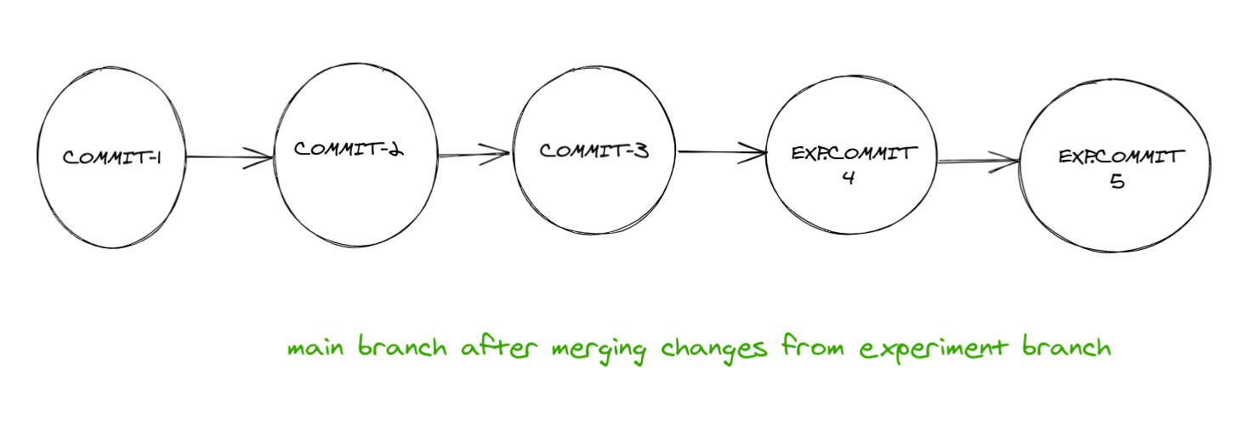
master branch after merging changes from exp branch
Notes:
// Branching is like Save as - https://betterexplained.com/articles/aha-moments-when-learning-git/
Now I want to think you repository as a series of commits. C1 -> C2 -> C3 (IMAGE OF C1 -> C2 -> C3)
What if u want to try out a new experiment, but u are not sure whether to include it in the final draft or not?
And u don’t want to mess with the main repository
What would you do?
Create a copy of the repository, give a different name to it!
Now what if u want to perform multiple experiments(more than 1)?
Multiple folders?
Lets assume u have 3 such folders, the main and other 2 experimental.
Luckily both ur experiments went good! And u want to have both of them in ur final draft
What do u do, open 2 repos at once, compare file by file the difference and ultimately include the changes in one repository
This is such a pain
Git provides a feature called `branches` which help u achive the same with very little effort
After C3 u want to experiment, so u hop on to a new “branch” which we call “experiment” (IMAGE OF NEW BRANCH C1 -> C2 -> C3). Its called a branch because it is kind of diverging from the tree
And u make 2 new commits say E1 and E2 (IMAGE OF E1 and E2)
And u are happy with the code, so ultimately u would like those changes in the master branch! (IMAGE OF C1->C2->C3->E1->E2 and below branch)
U can simply merge them in master and Delete off the experimental Branch(ONLY master image)
Now with hands can get a better understanding
Git branch -Now by defautl u are on a branch called master
So u want to experiment a new feature in FB-clone called “poke”
So u create a branch called “poke” by git branch poke
Do git branch again and show that there are 2 branches
But u are still on master
To shift to the poke branch, do git checkout poke
Do git log and see
Now u see that u have the same history of commits
and lets add poke feature - git add ., git comit -m “added poke”
And git log, u have poke feature on ur poke branch
And it seems good and u want include this on master
go to master and do git log
U see the “poke “ commit is not there because it was on a different branch -”poke”
So what u want to do is literally merge those changes in master branch,
So that comand is git merge the branch name
Git log , show them that poke commit is there
And show the file
Tell them u can delete the branch by git branch -D poke

Slide 29
Hands On
Make a branch named poke and add poke feature

Slide 30
DOUBTS

Slide 31
Alone we can do so little, together we can do so much
-Helen Keller
Notes:
The repository is on your machine! We need a platform where colloborators from different parts of the world and work together smoothly
Imagine google docs, it enables different people to edit a single document
But code is complicated, consisting several files of several formats
A popular platform that supports such colloboration is “Github”
Track bugs
Submit code in form of something called Pull Requests
The repository is on ur computer only
What if other people want to look at the code
Suggest changes, fix bugs, improve it
U need an online platform where people can colloborate
This is where github comes into picture

Slide 32

Let’s rock push and roll pull
Notes:
You can put ur code on github enabling others to colloborate
In Github
Make a new repository
Copy the link
Git push LINK_COPIED master main
Refresh it and show

Slide 33
Remotes
origin = https://github.com/username/repoName
Notes:
Make changes in README.md and do
Git pull LINK_COPIED master main
Now instead of having to type the link everytime you can use a single variable to save the link
Such variables are called “remote”
Git remote -v
Nothing shows up
Git remote add origin LINK_COPIED
Git remote -v
DEMO by doing this time
Git push origin master main
Git pull origin master main
You can push seperate branch too.Demo by make another branch - progress
Git push origin progress
Show in github !
Now it has been a pain to copy and paste the link
Lets store in a variable
Such variables are called Remote!
Git remote -v
Nothing
Git remote add origin LINK
Git remote -v
Make some commit
Git push origin main

Slide 34
DOUBTS

Slide 35
Demo - Send a PR
Fork
Clone
Make a new branch and hop on to it
Code and Commit
Push
Pull Request
Notes:
Go to issues !
See the issues
Tell them this looks like i can solve it
Explain y u need to fork-
U want to have ur own copy of the repository and build things upon it!
It is not a good idea to push the code directly to their repo and messing it up, you need to have ur own copy, hence fork it
Now it is on github but not on ur machine
Clone it !
Generealy it is a good practice that u don’t play around with master branch, even while sending a PR, people use master branch to keep in sync with the original master branch(we will see)
But for now, take away is, before sending a PR, make a branch with a proper name - NOT BINOD, but something to related to feature u r adding
Git branch “BRANCH_NAME”
Git checkout BRANCH_NAME
Fix bug
Git add -A
Git commit -m “added this to so”
Git remote -v
Git push origin BRANCH_NAME
Open github
It already shows a feature of PR-
Explain that PR means “Please accept these lines of Code in ur code base”
Tell someone to merge it. And show those changes in the mastermain of the original repo of KOSS
Update ur master main
Git remote add upstream KOSS_REPO_LINK
Git checkout master main
Git pull upstream master main
Before making a new branch, ensure that u update ur master!
Git checkout -b for A NEW FEATURE and this cycle continues !

Slide 36


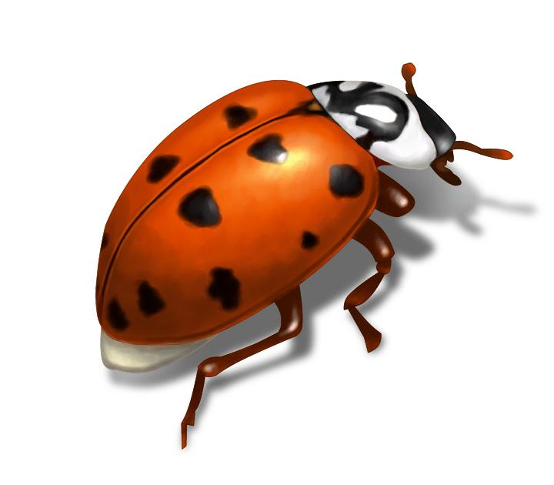

Workflow - Contributing to a Repository on
kossiitkgp/codebase
Notes:
A recap on what we did

Slide 37

Workflow - Contributing to a Repository on
I can fix this!
kossiitkgp/codebase
Notes:
A recap on what we did

Slide 38

Workflow - Contributing to a Repository on
eric/codebase
kossiitkgp/codebase

Slide 39

Workflow - Contributing to a Repository on
eric/codebase
kossiitkgp/codebase
Clone

Slide 40
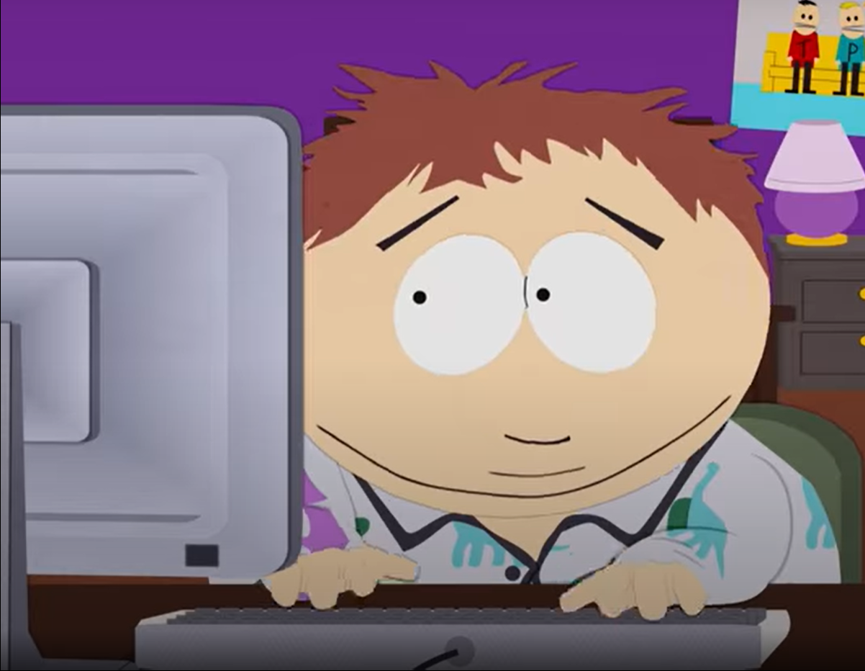
Workflow - Contributing to a Repository on

Slide 41
Workflow - Contributing to a Repository on
eric/codebase
Eric works hard and fixes the bug and he
PUSHES

Slide 42
Workflow - Contributing to a Repository on
Pull Request
eric/codebase
kossiitkgp/codebase

Slide 43
Workflow - Contributing to a Repository on
After MERGING the Pull Request, it is now free of bugs!
kossiitkgp/codebase

Slide 44

We want you to send a PR
Notes:
Ask them to send a PR to `github.com/kossiitkgp/git-and-githubworkshop-2020`
JS,C , python file
Bug in addition code
Or add a subtraction code

Slide 45
Some good places to try out
Check out metakgp repositories
Issues with label - good-first-issue
Participate in KWoC-2020(Keep following KOSS on facebook for updates)

Slide 46
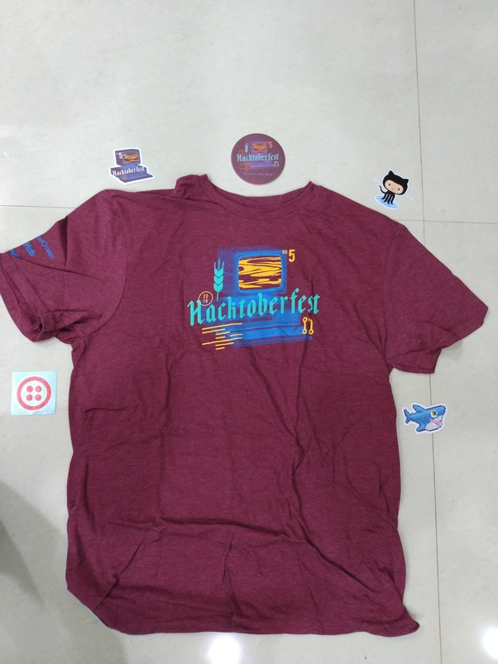
For more...
Check out for advance resources here
Get GitHub Student Pack
Participate in Hacktoberfest
Checkout out Github Pages, host your static site for free

